Slide 1

Federated BIM
Léon van Berlo

Slide 2

There is NO central BIM!
http://www.slideshare.net/berlotti/there-is-no-central-bim-model

Slide 3
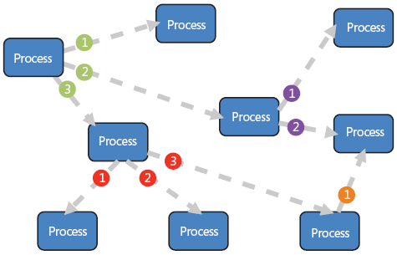
Event driven IT architecture
http://msdn.microsoft.com/en-us/library/dd129913.aspx

Slide 4
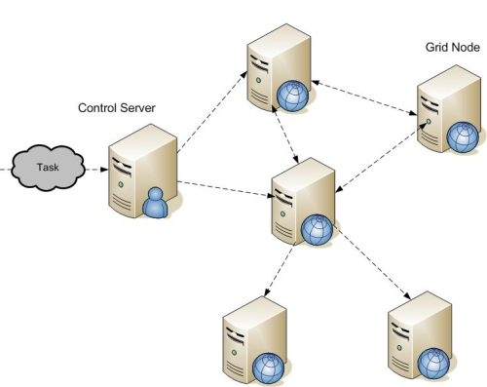
There is NO central server!

Slide 5
Some supplier
automodeller
Clashdetection
service
BIMserver
Validationchecker
whatever
whatever
LOD checker
CO2 lifecycle
calculation
Viewer

Slide 6
An example

Slide 7
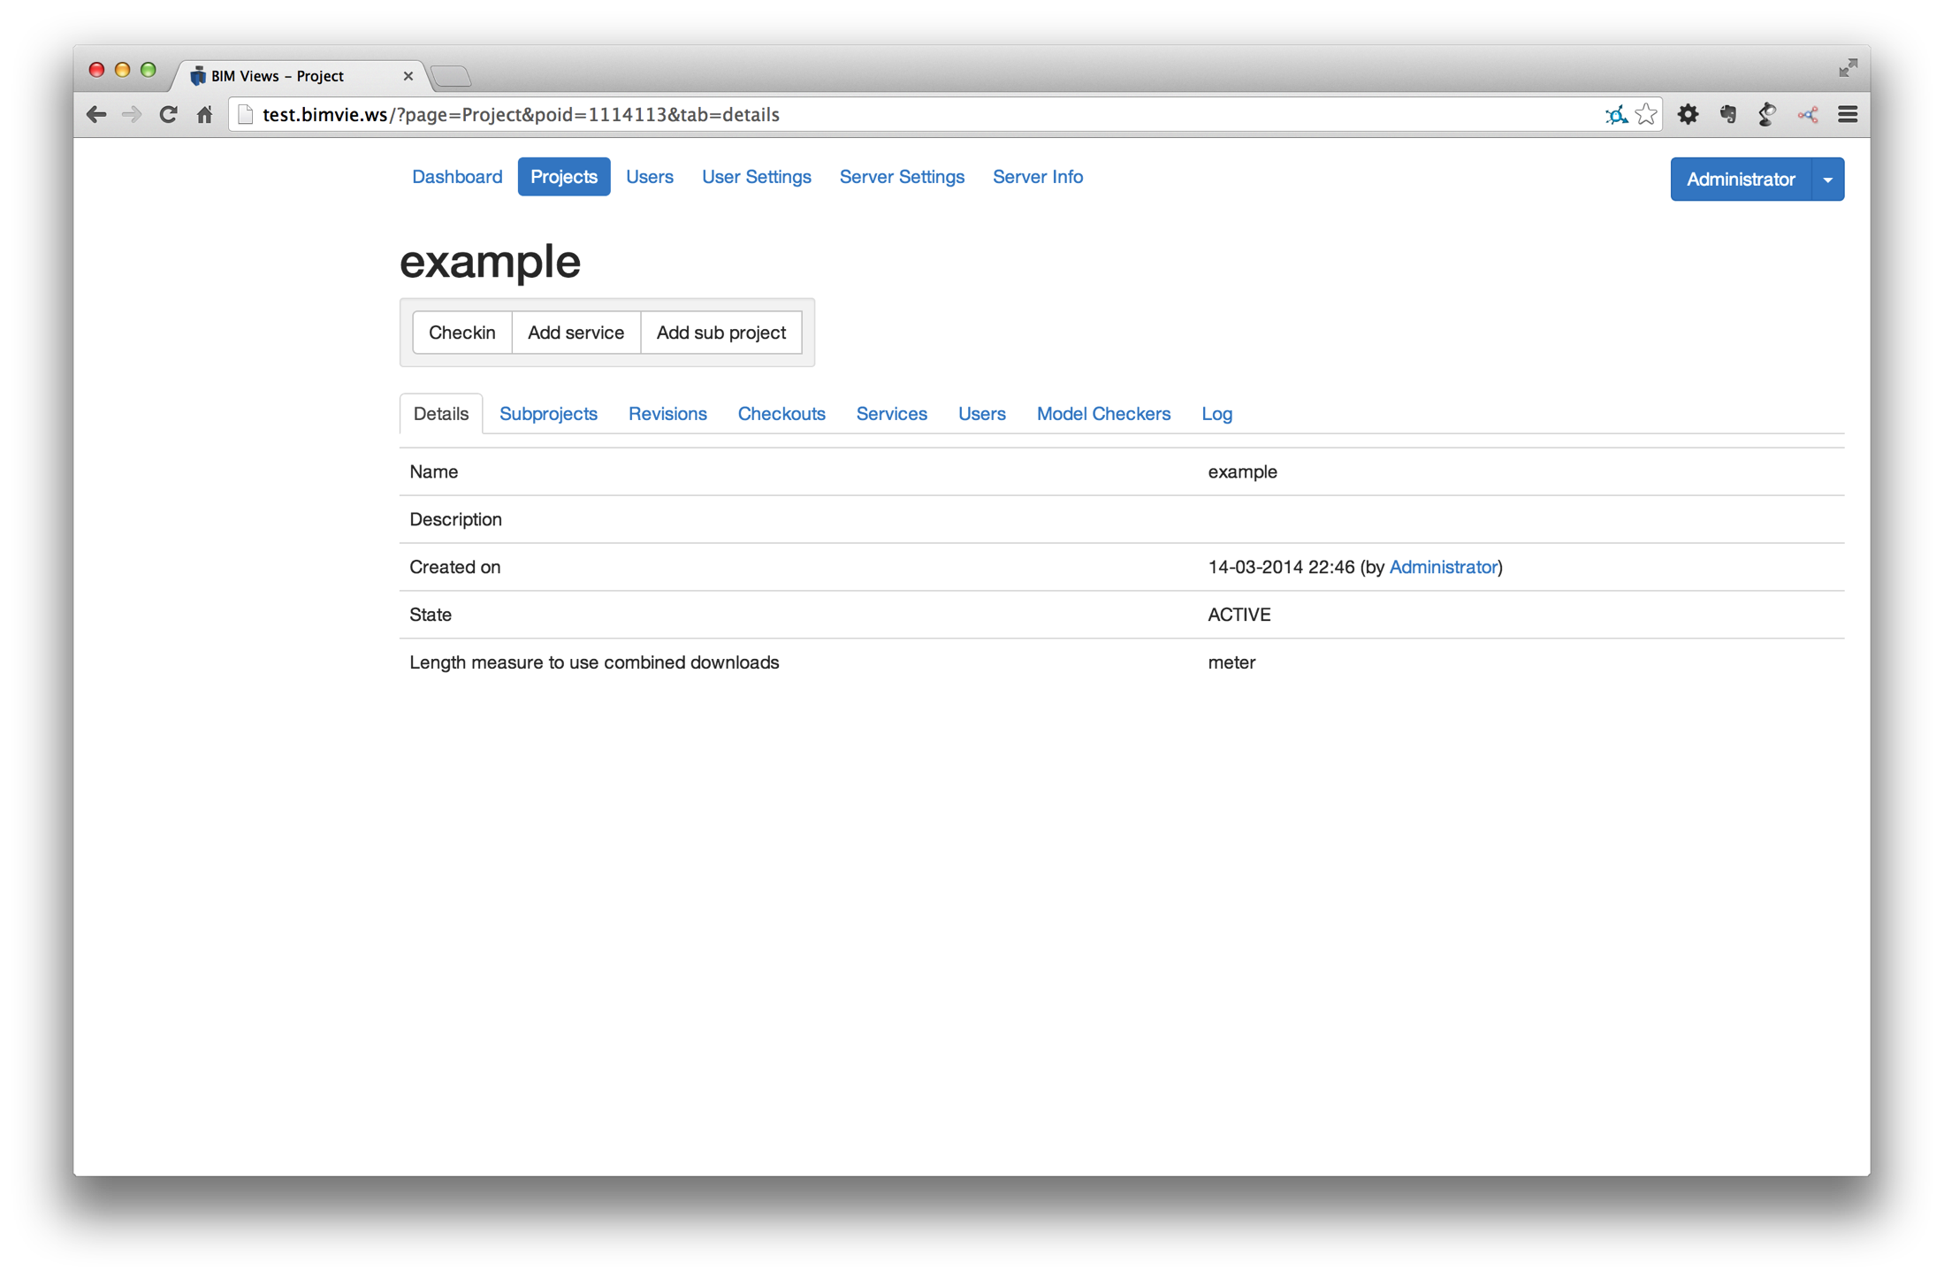

Slide 8
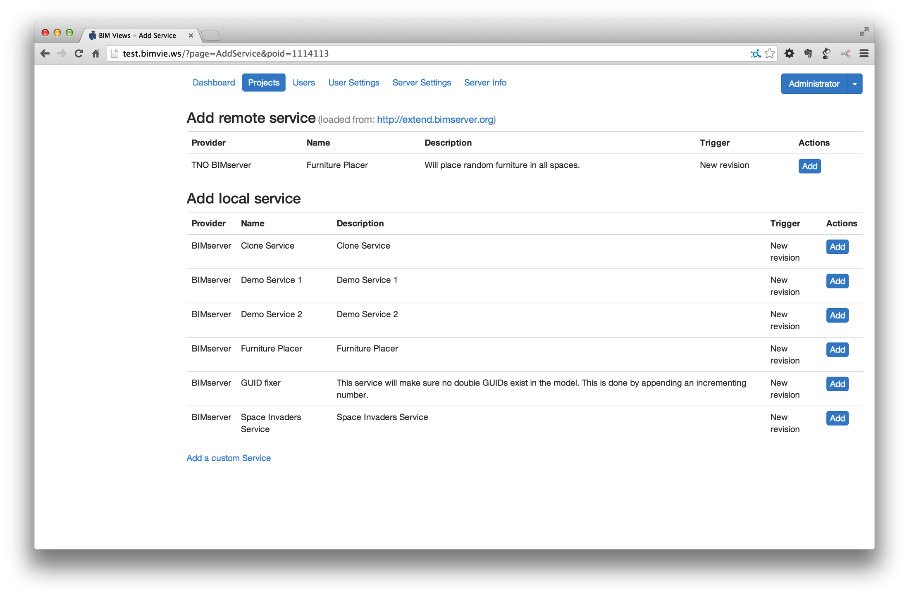

Slide 9
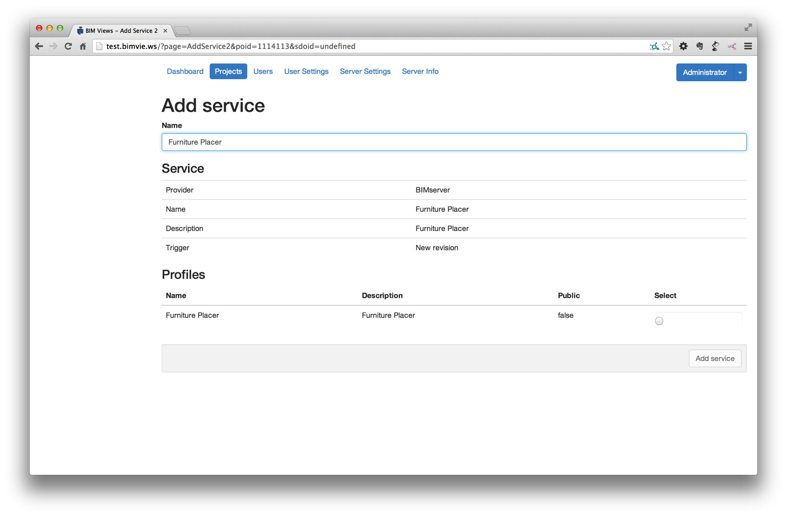

Slide 10
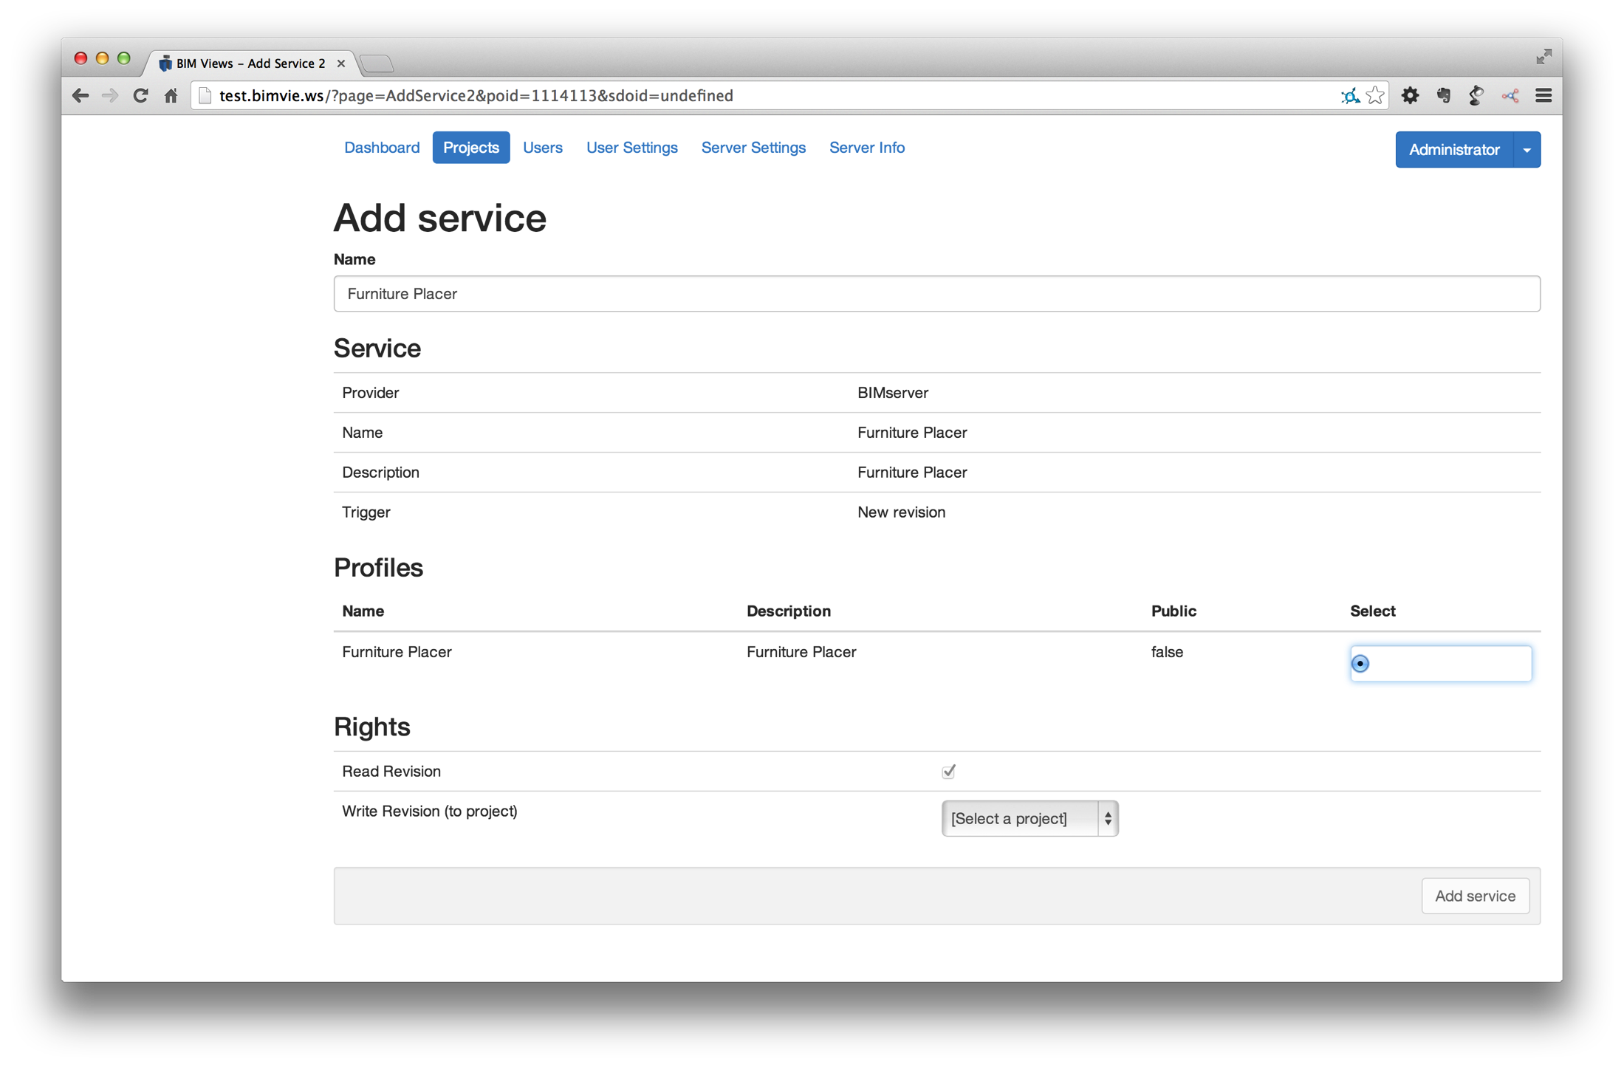

Slide 11
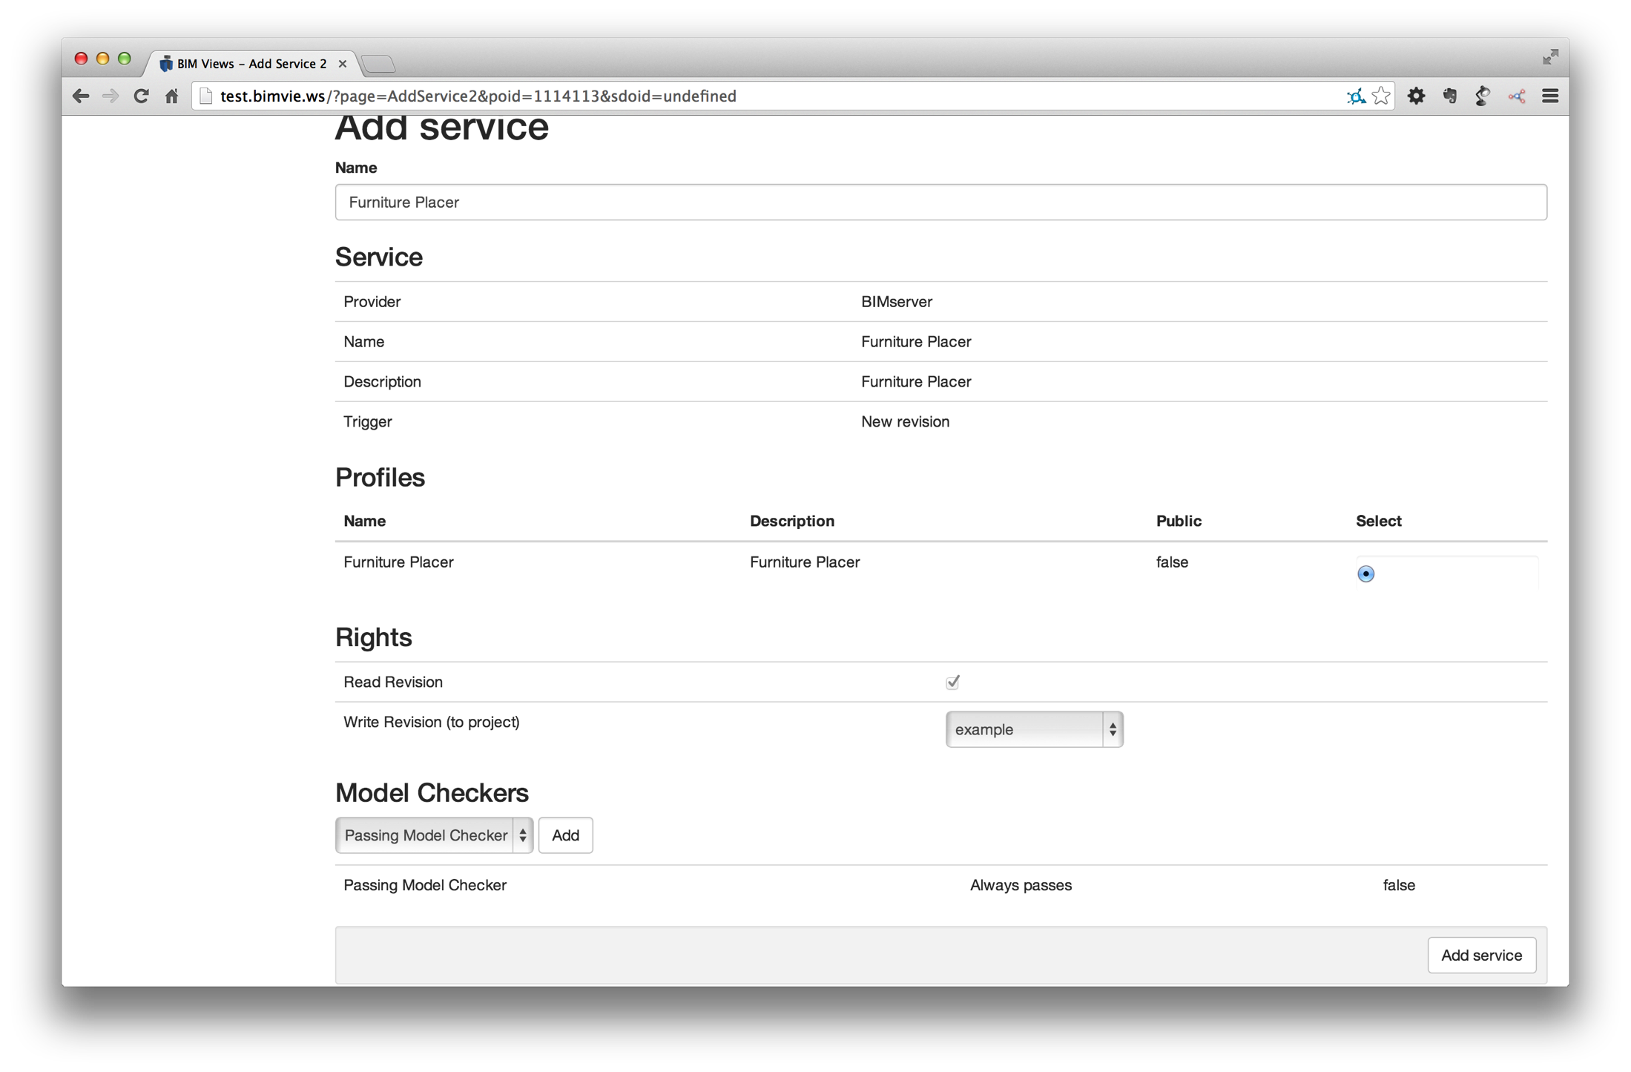

Slide 12


Slide 13
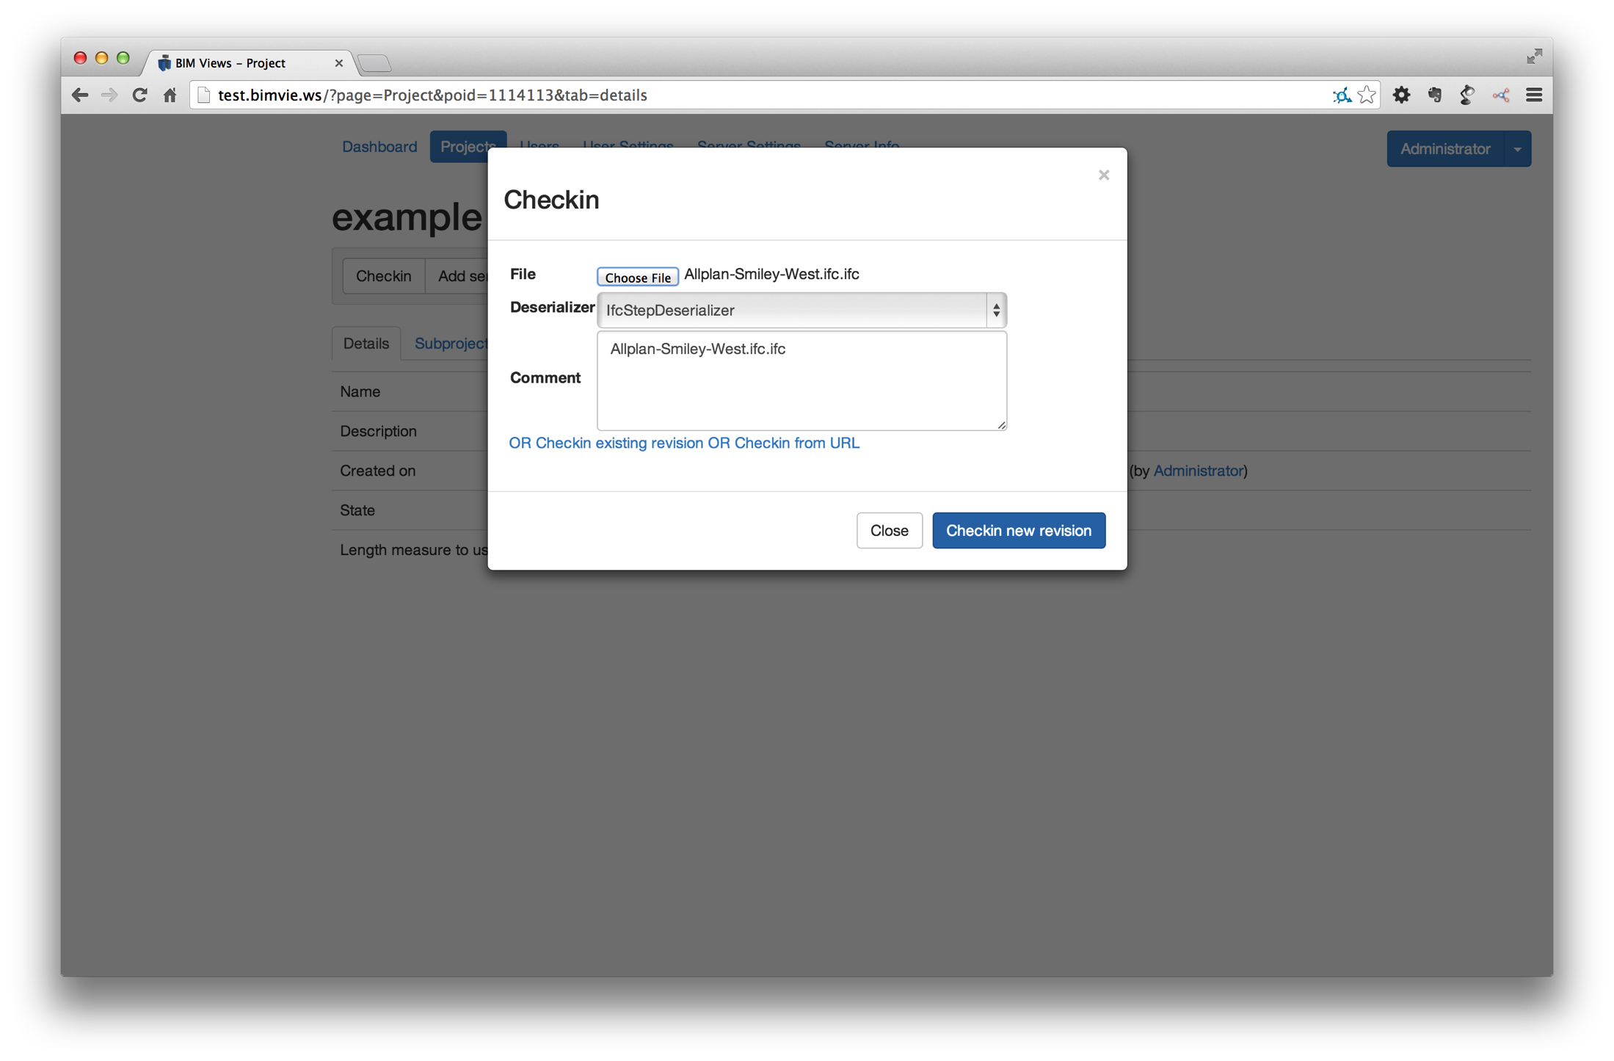

Slide 14
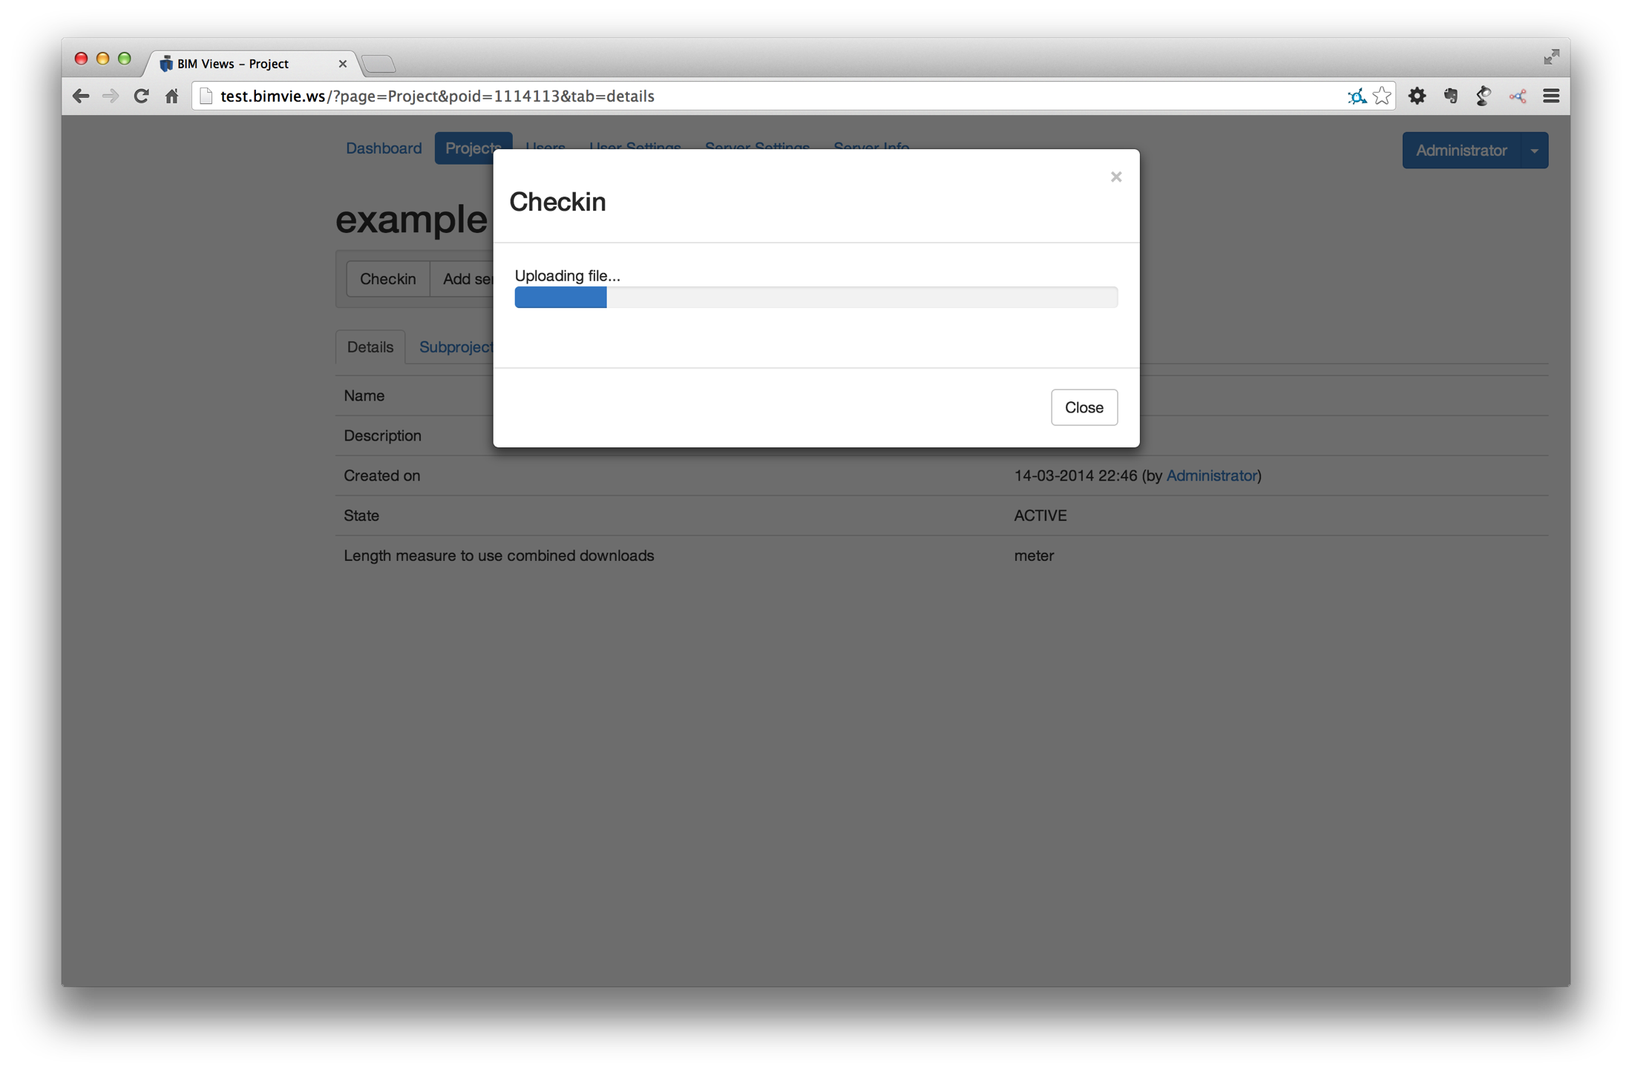

Slide 15
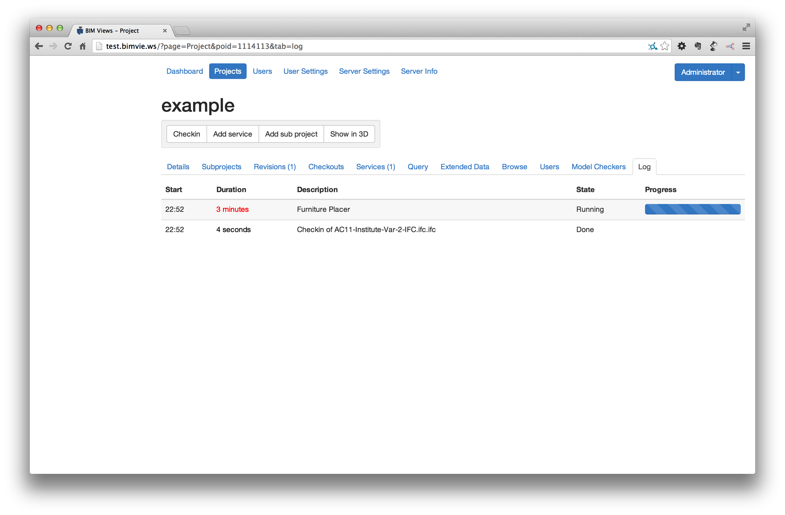

Slide 16
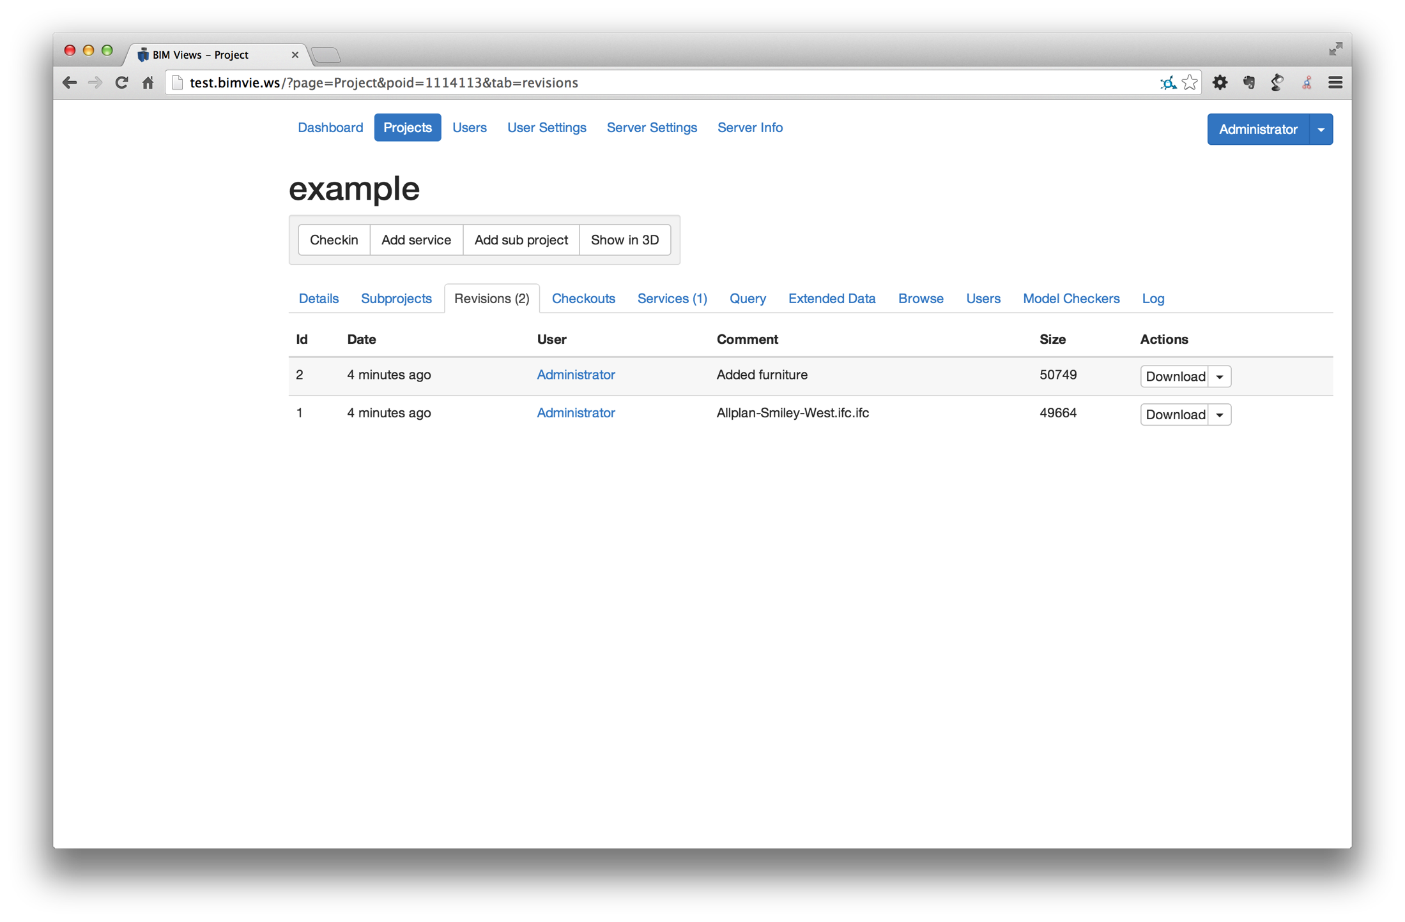

Slide 17
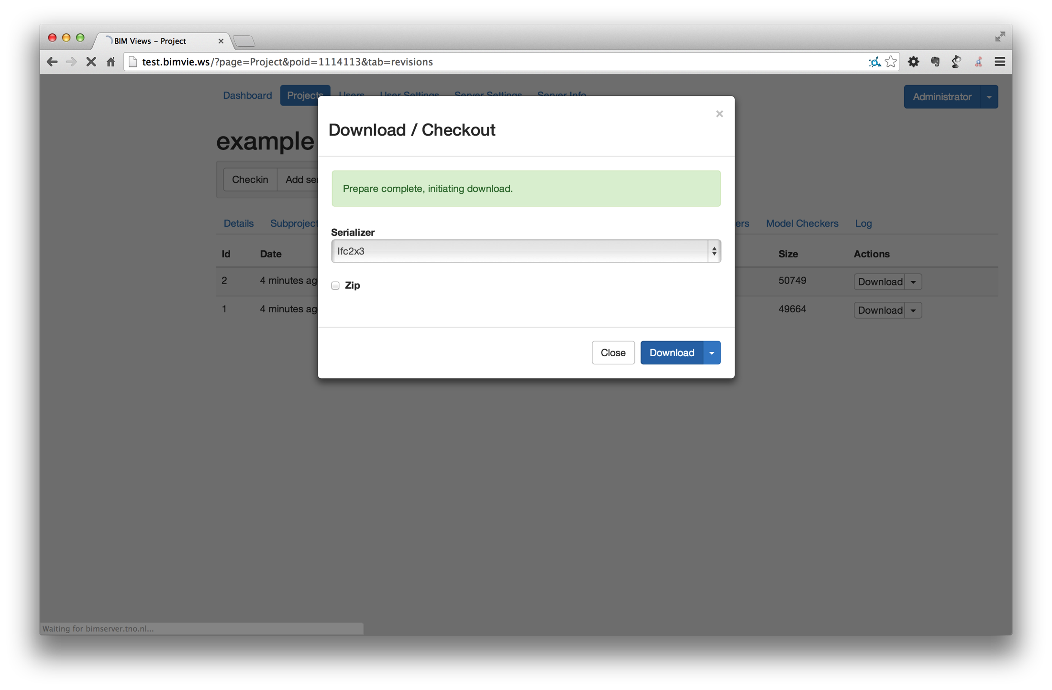

Slide 18
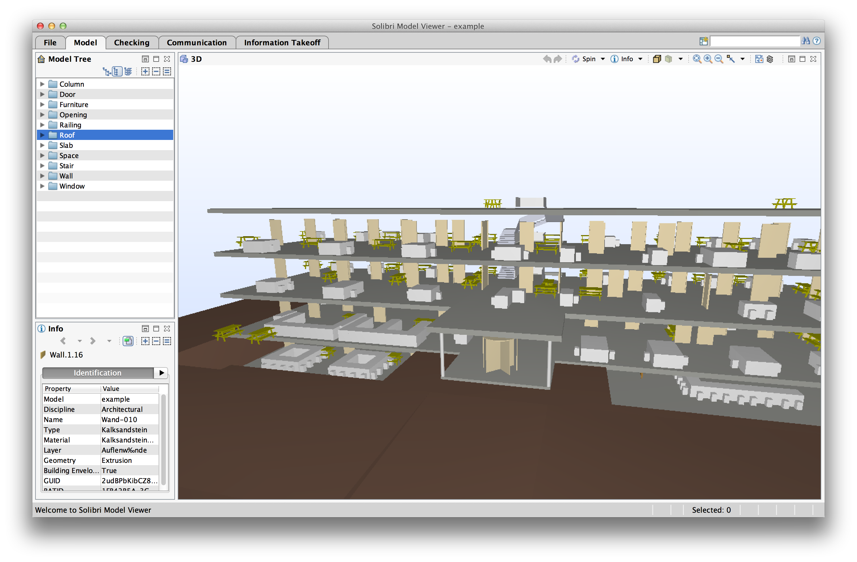

Slide 19
Sidestep: Non-IFC results returning to BIMserver

Slide 20
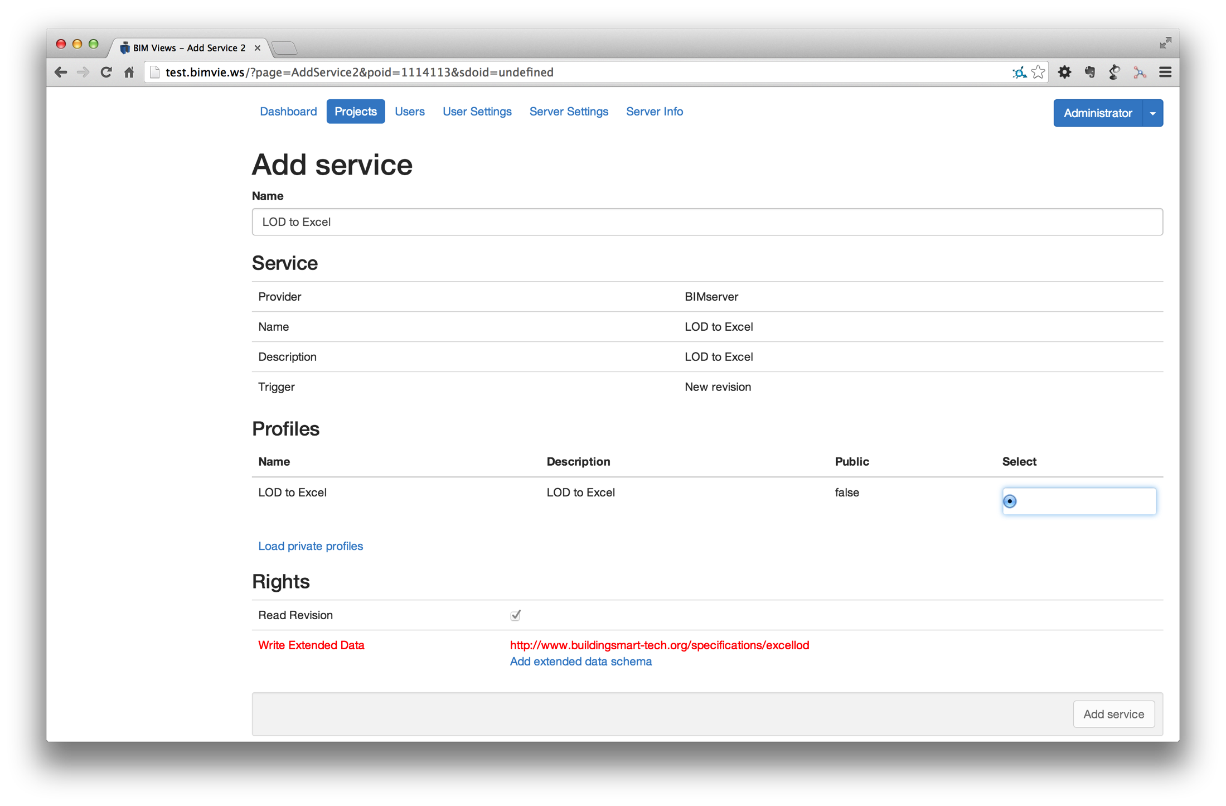

Slide 21
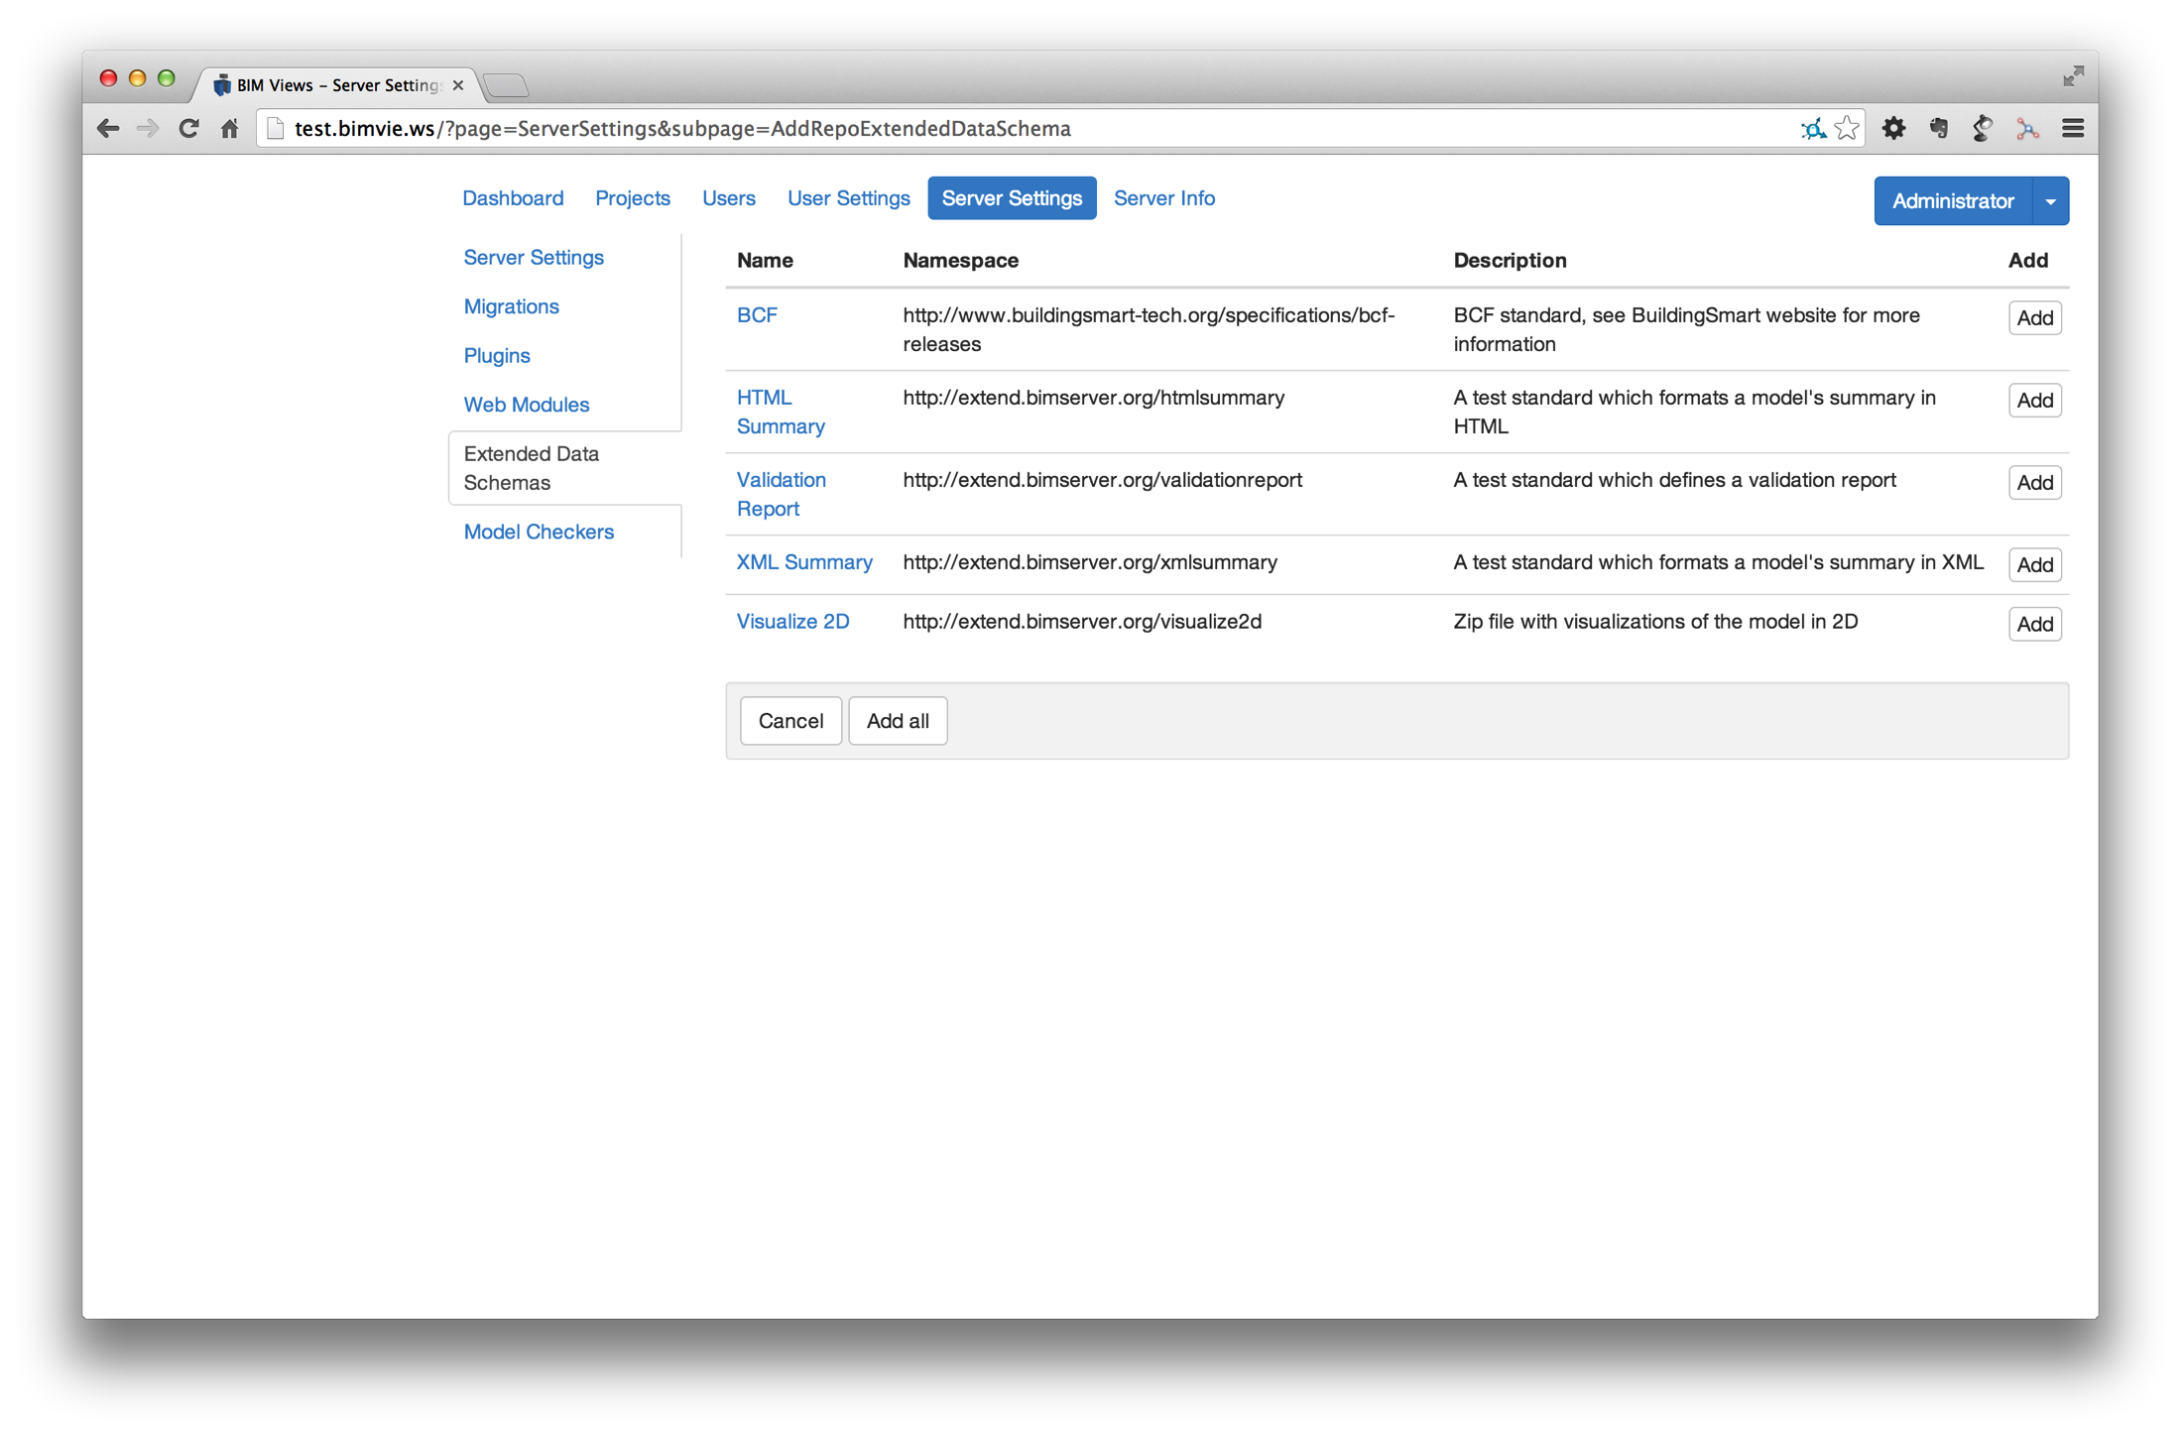

Slide 22
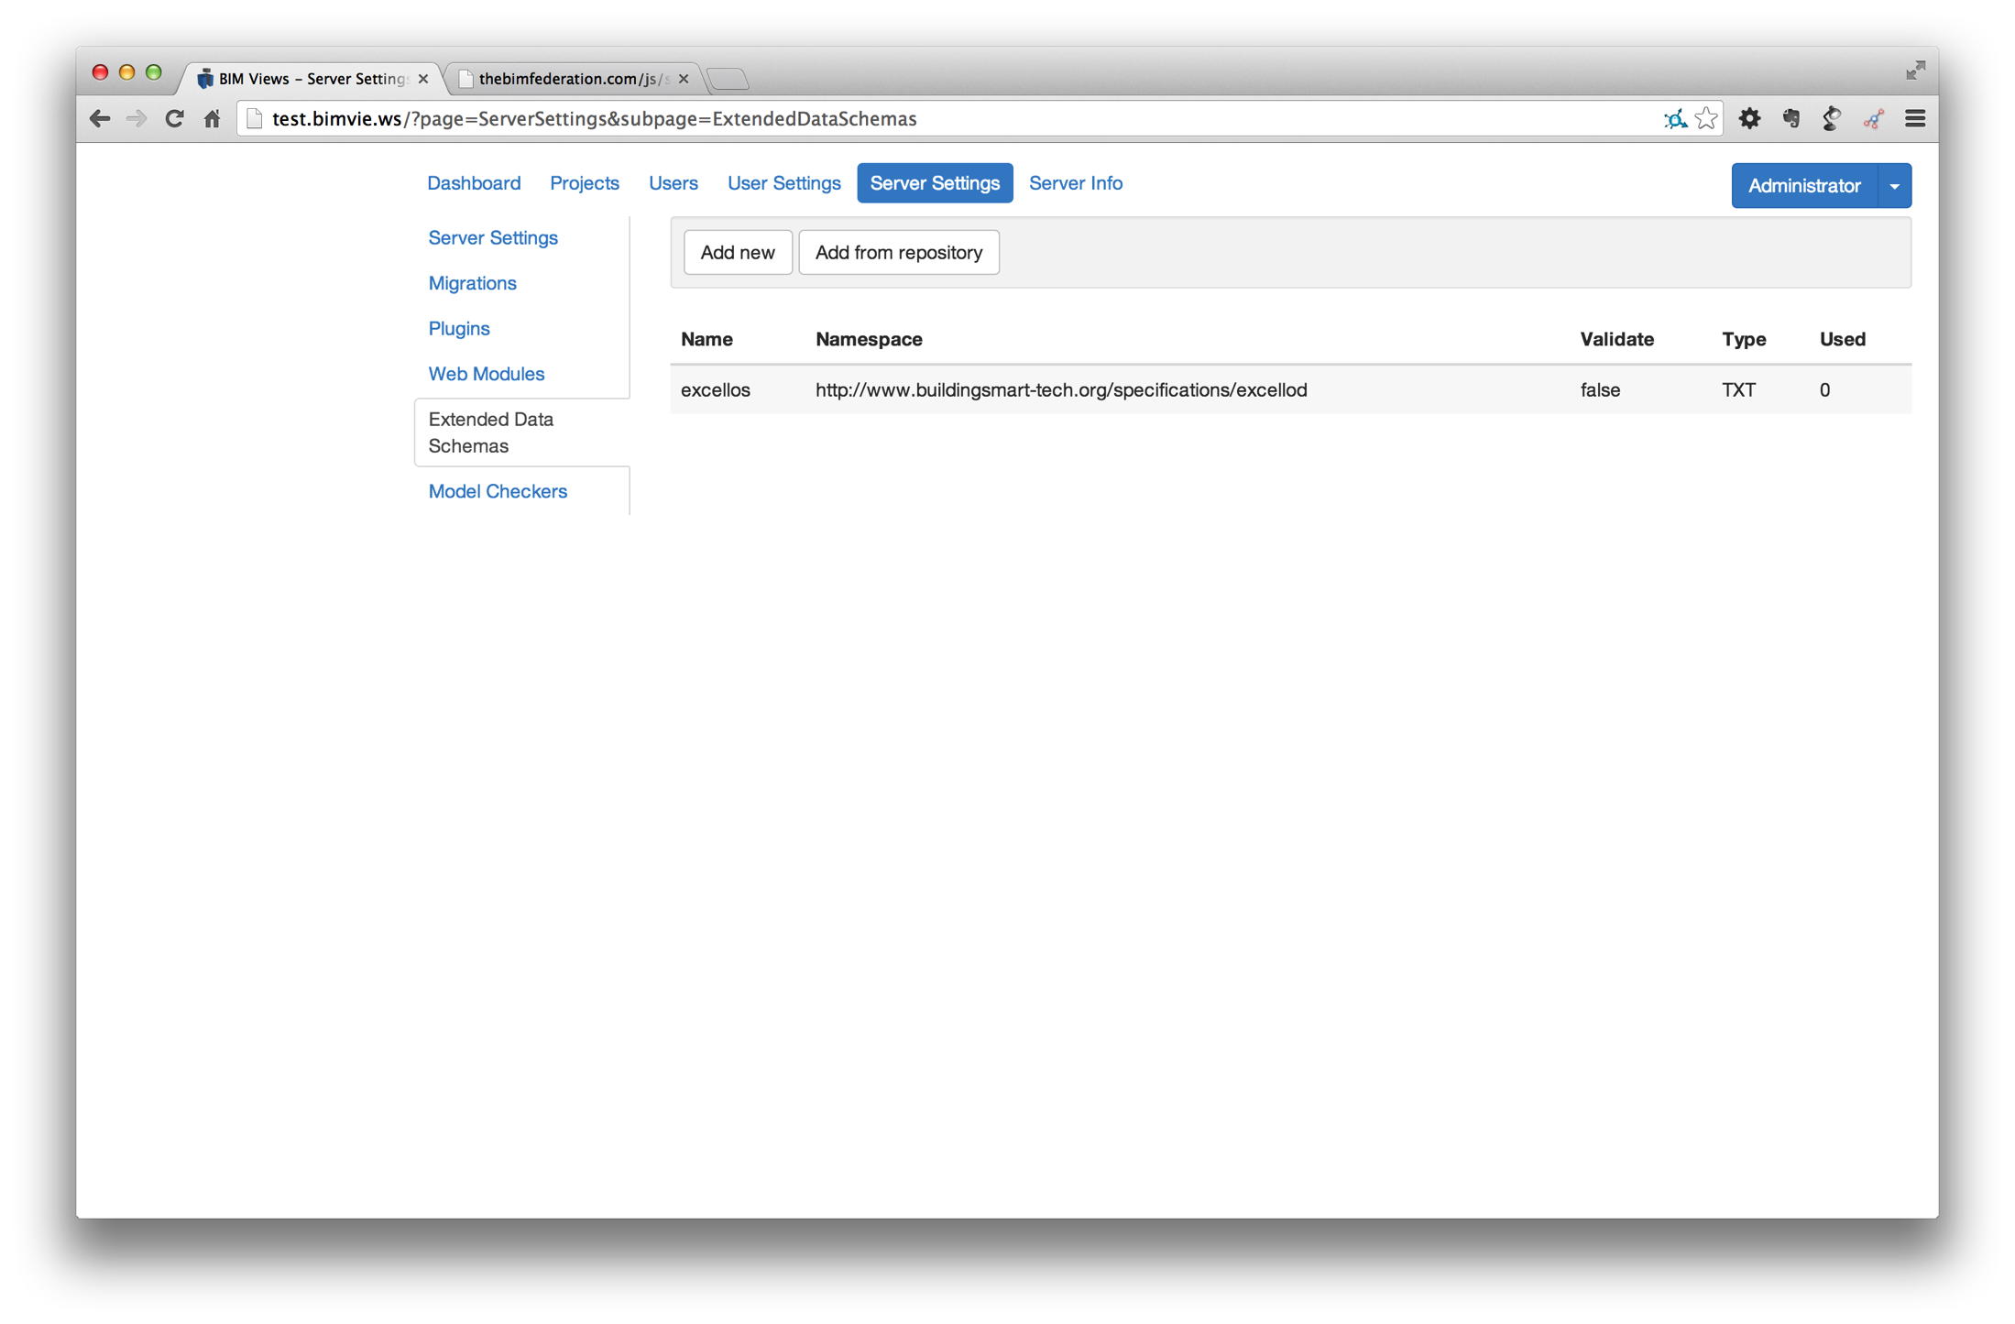

Slide 23
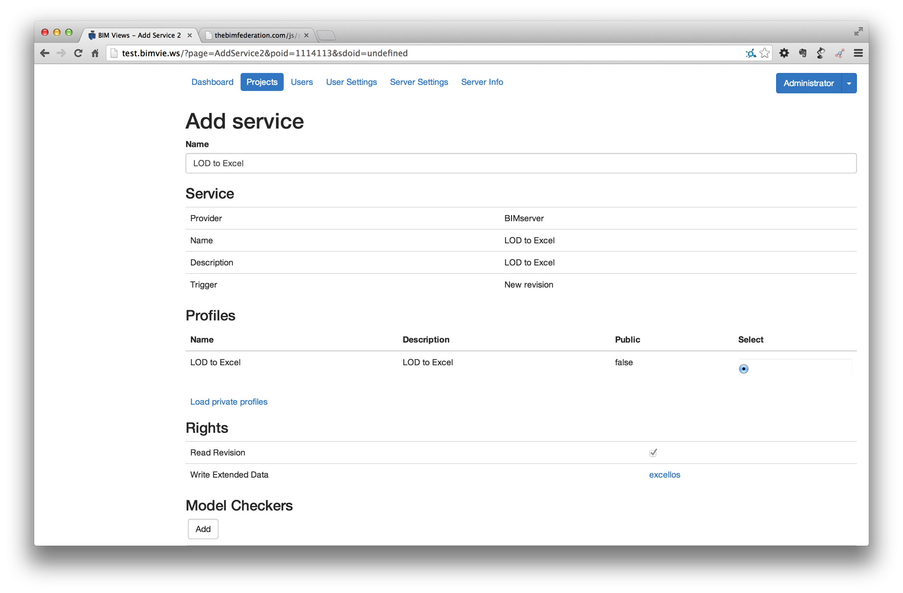

Slide 24
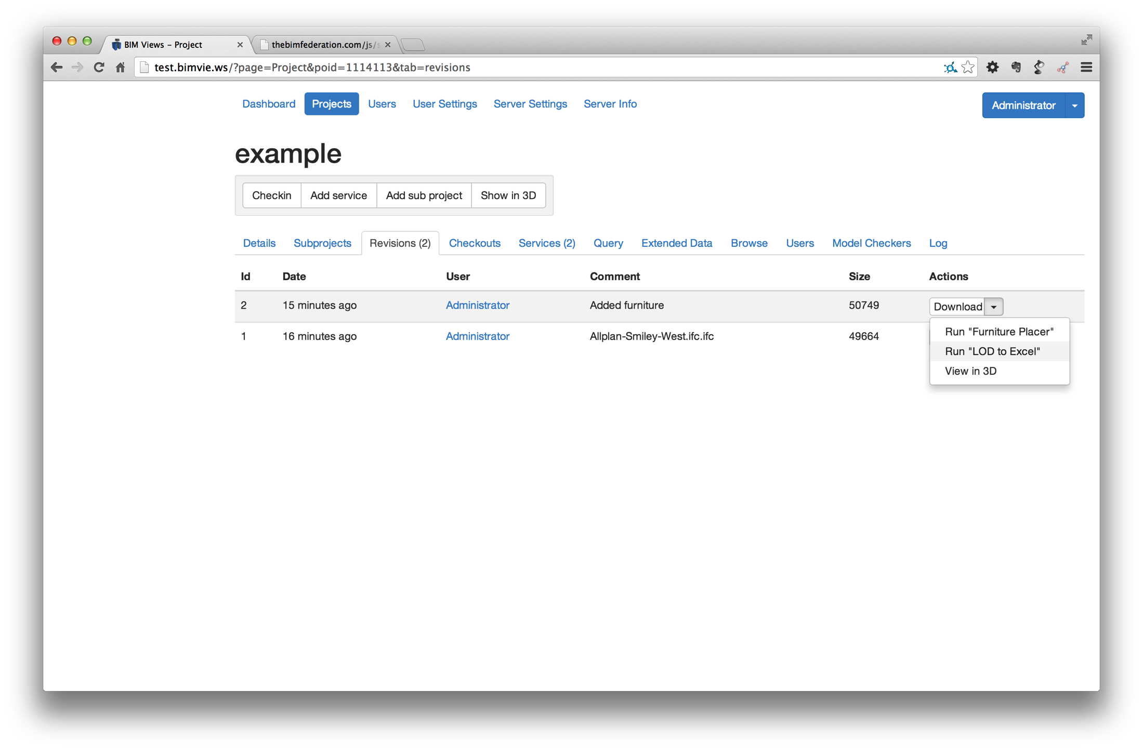

Slide 25
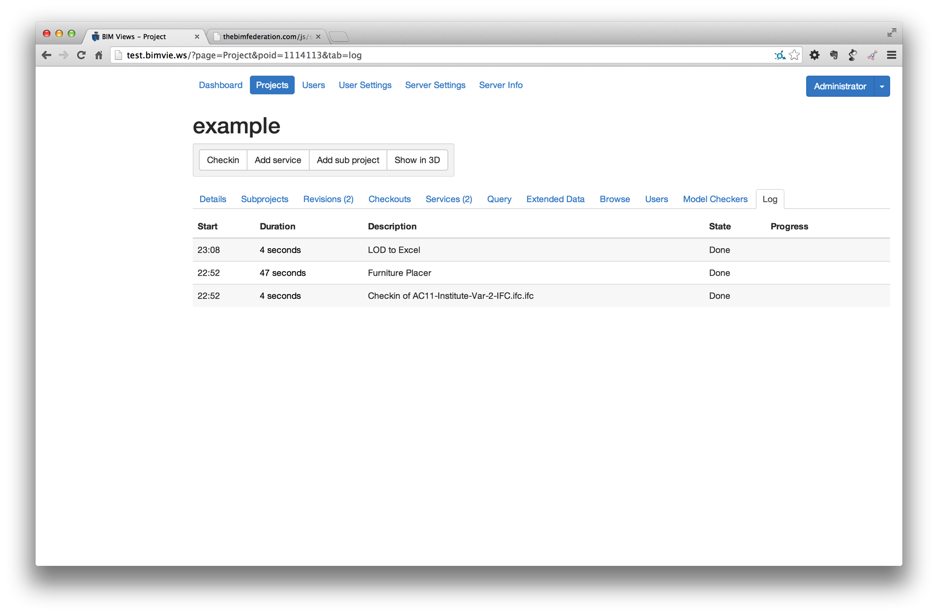

Slide 26
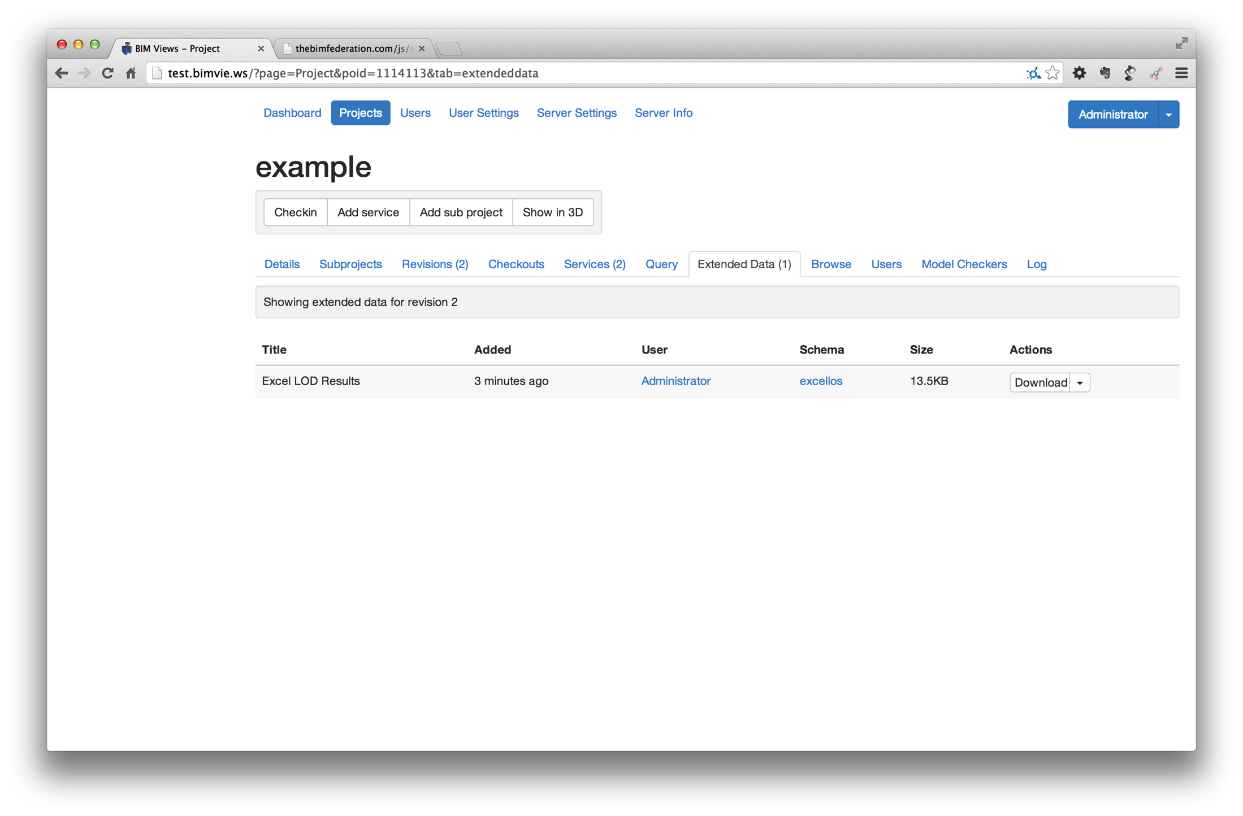

Slide 27
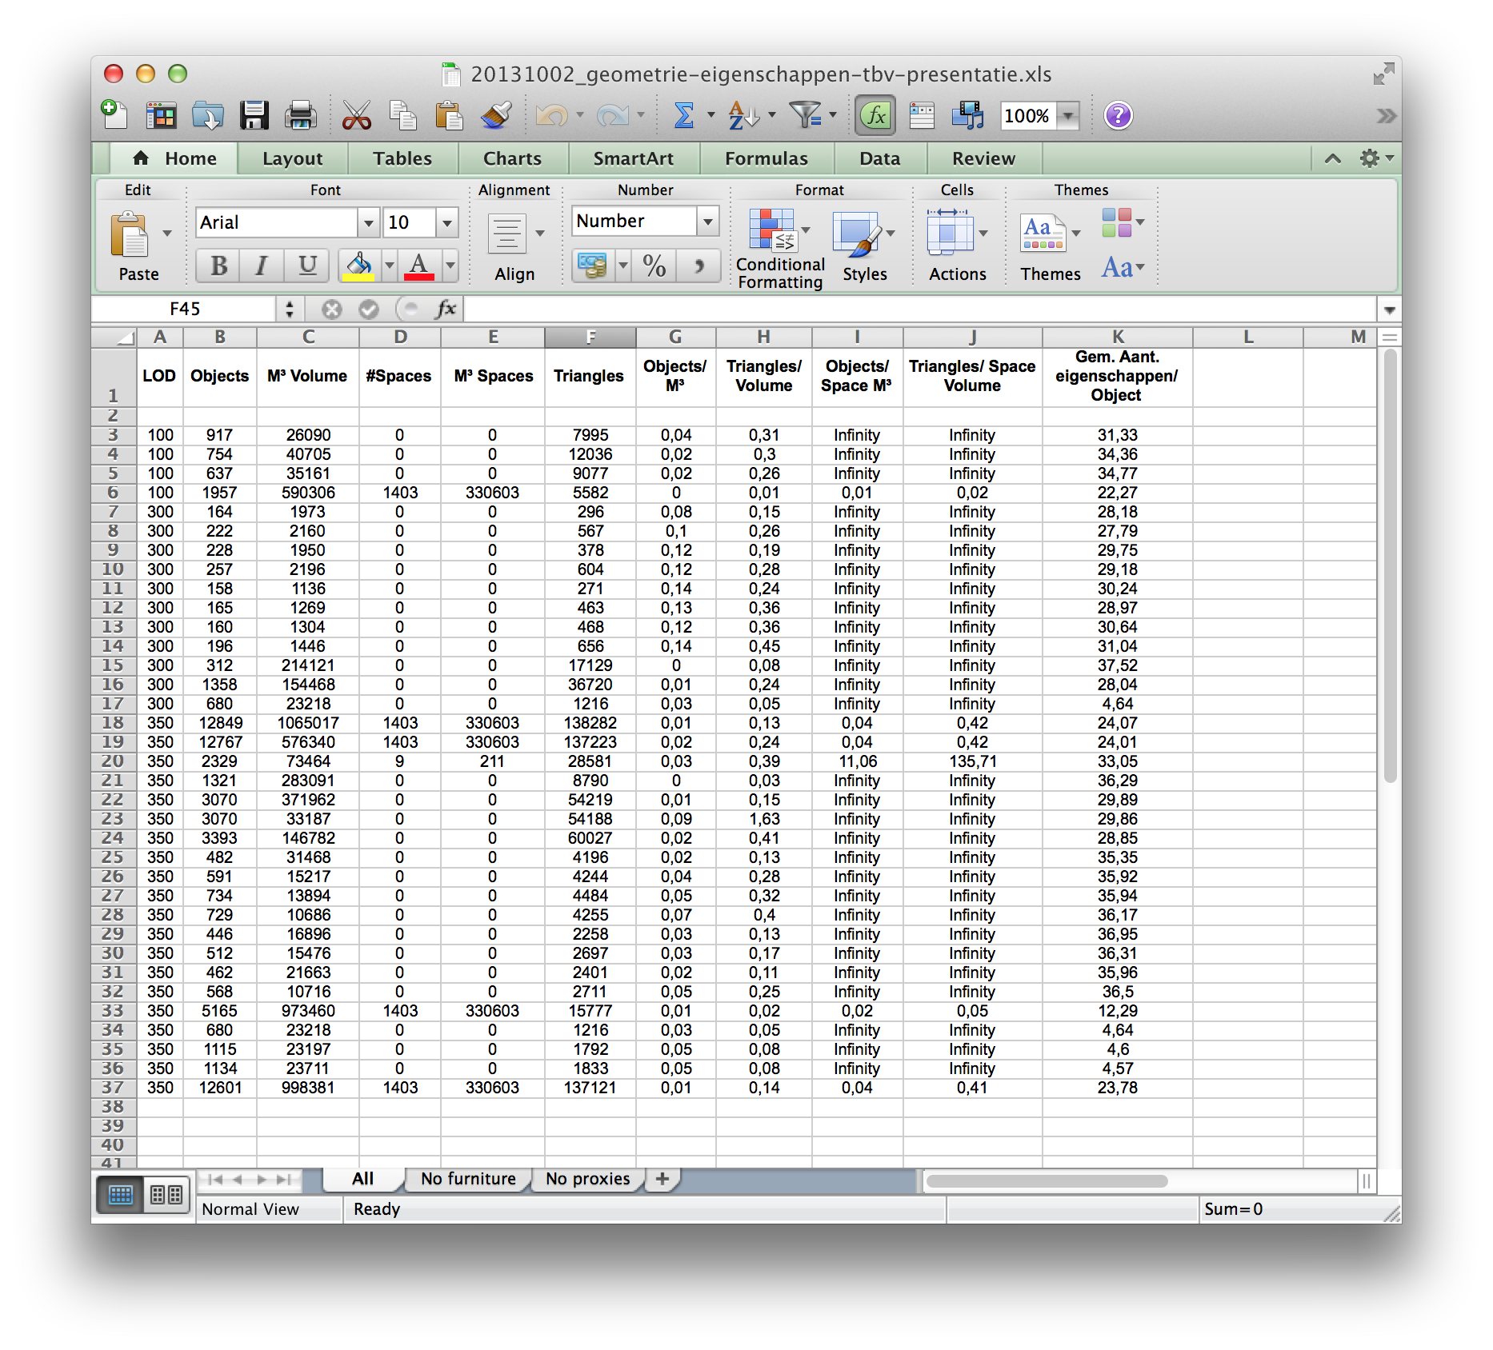

Slide 28
What happenend?
User: check-in model (IFC)
GUI: communicating with server
Server: storing model in database**
Server: model check if data is according to ruleset
Server: sending notification to subscribed service about new revision
Remote Service: getting model (with token) from server *
Remote Service: analysing model *
Remote Service: sending result back to server *
Server: checking result is valid and authorised to receive
Server: adding result to ‘extended data’ or new project revision
GUI: viewing or downloading result
** = model check can also be placed before storing data
* = constant interaction between service/server/gui about status

Slide 29
The big(ger) picture: Results can trigger other (remote) services and: Remote services can trigger remote-remote services

Slide 30
The big picture

Slide 31
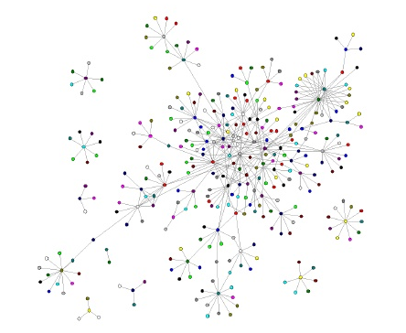
Niche applications
BIM services like:
Bimserver (“BIM Data service”)
Clashdetection
CO2 life cycle calculation
Floorplan generator
Supplier automators (staircase, floors,etc)
Android app
Loggers and analyses
Validation checkers
Furniture placer
SpaceInvaders app
PNG renderer
2D Floorplan generator
….
Everything automatic and ‘on demand’ event driven

Slide 32
Current (old) demonstrator
1. Checkin model (bimserver)
- Staircase supplier sends staircase model (IFC)
- Floorsupplier(IFC)
- Innerwall supplier (IFC)
2. Clashdetection (BCF)
3. Check on IFC quality (Statsbygg / RGD)
4. CO2 life cycle analyses (PDF)
2. Sync with datastore of projectmembers
4. Client gets spreadsheet in dropbox

Slide 33
Current initiative for simple demonstrations
TheBIMfederation.com
Lists online BIMSie compliant services
Very simple; one upload (no revisions, submodels, etc)
Only one-to-one feedback (no iteration of events)
For now: only free services are supported (might change)
Goal:
Explain the federated concept
Lower threshold for people to jump into the ecosystem
Planned for April 2014

Slide 34
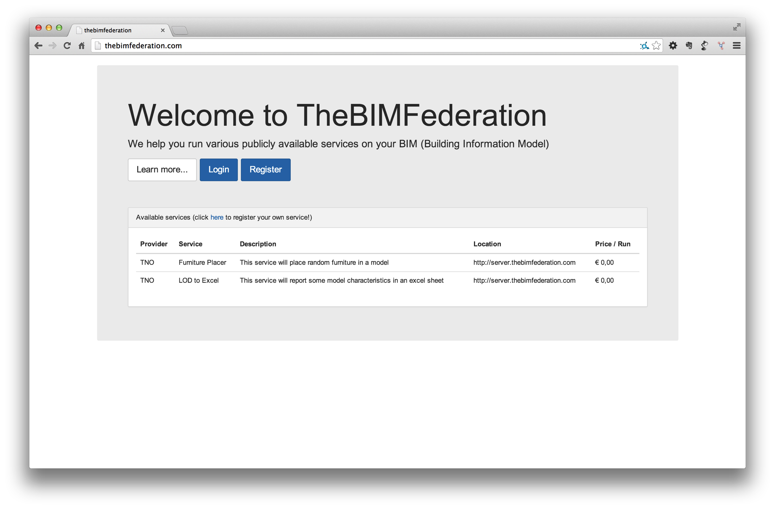

Slide 35
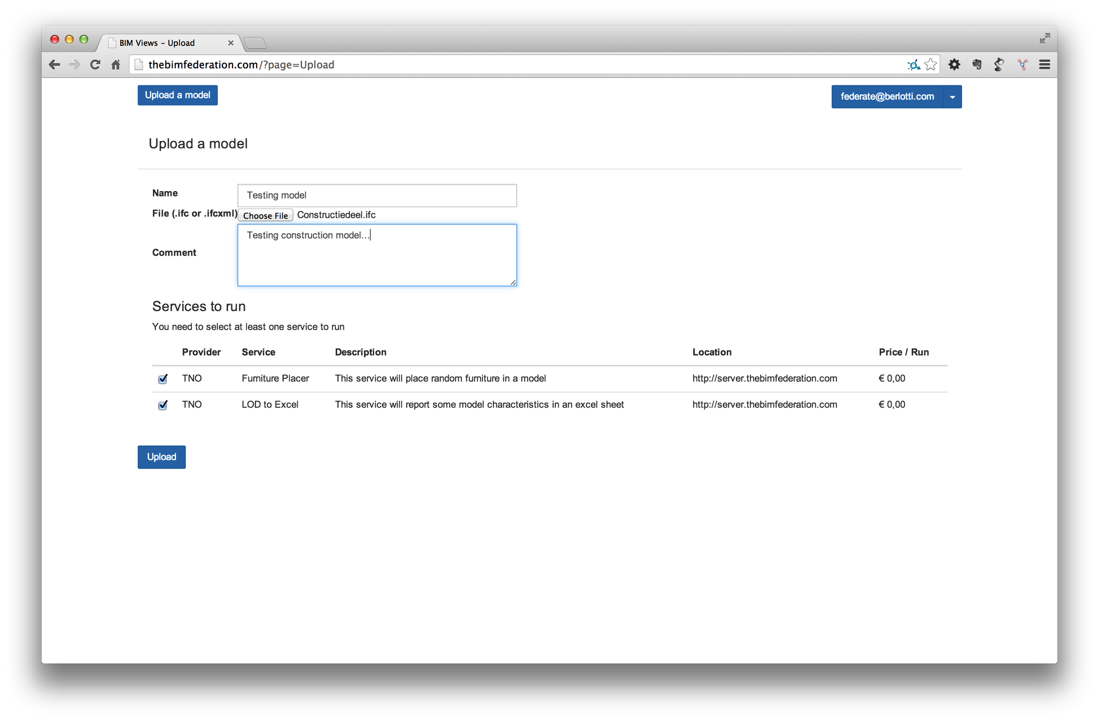

Slide 36
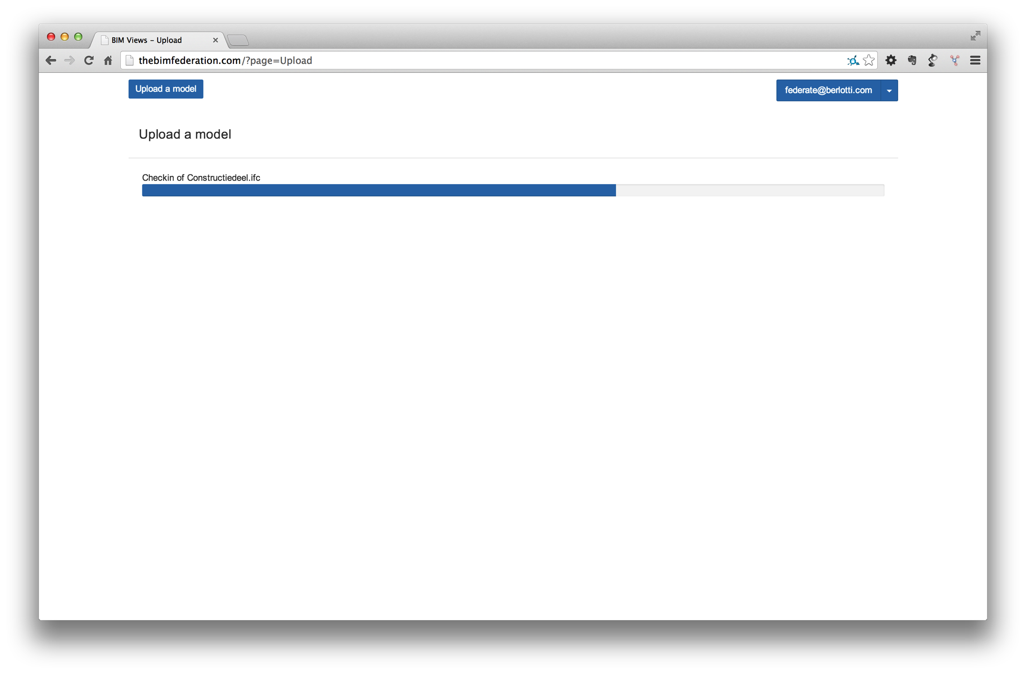

Slide 37
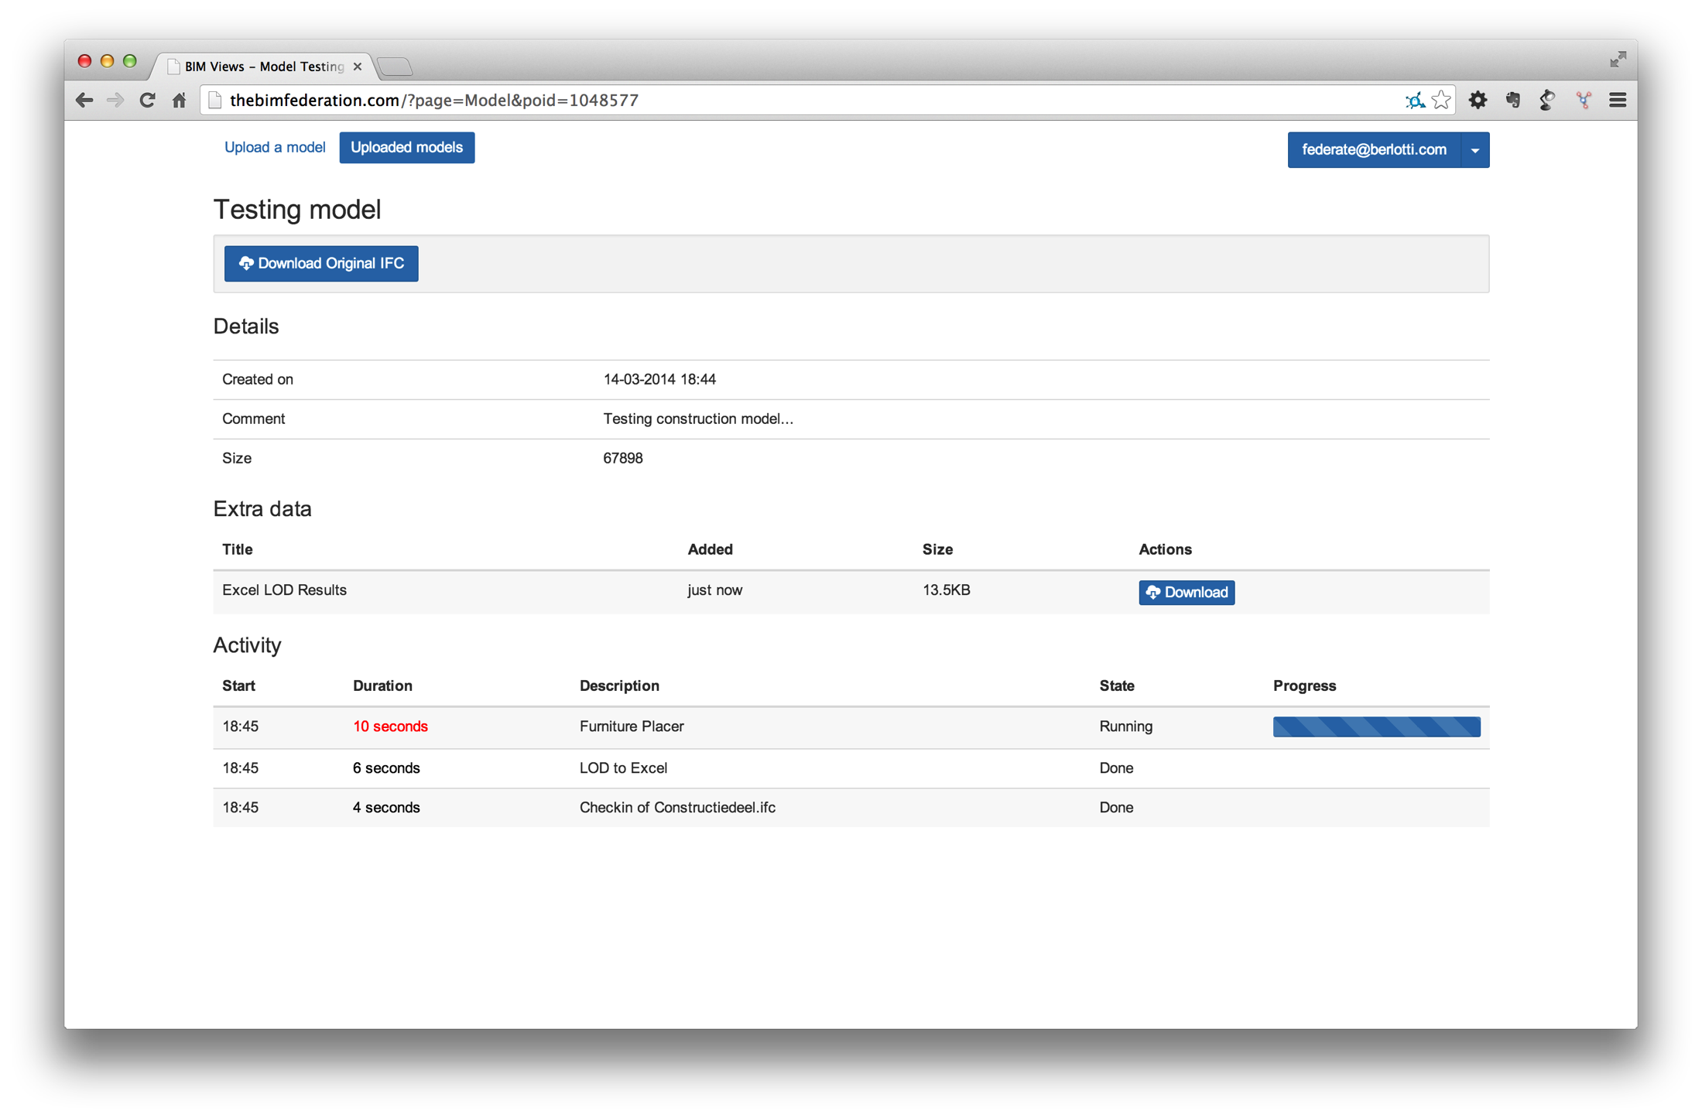

Slide 38
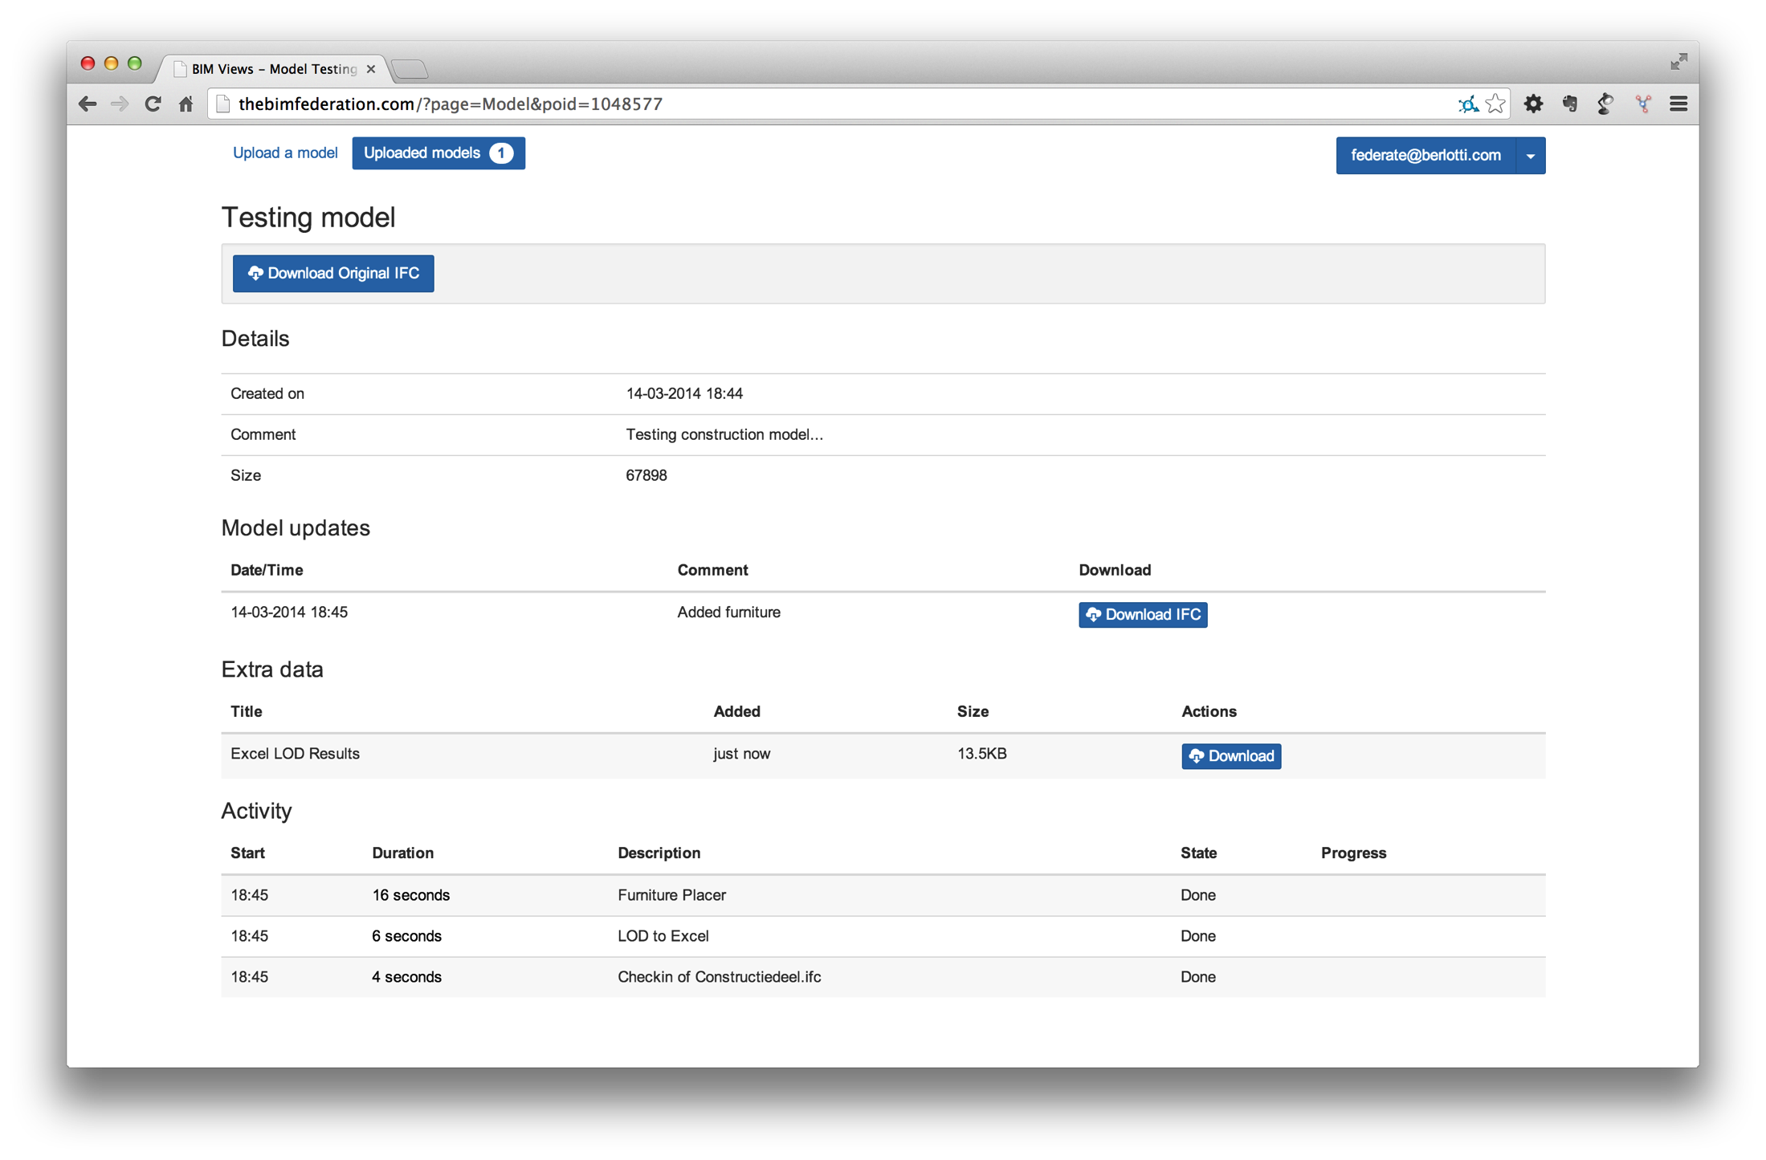

Slide 39
Limitations TheBIMFederation.com:
Yes
But you don’t need your own server to test it
Goal is to explain the concept; grow the ecosystem; give a podium to remote service providers
Advances users: BIMserver (also free)

Slide 40
Federated BIM conclusions:
Services can be closed source / ask money for specific features
Based on publish/subscribe principle (subscription to events)
Can be more than one per topic (competition)
Is centralized for the service provider
This:
Creates a new market for niche applications
Gets BIM into the web (“the cloud”)
Takes advantage of the fragmented nature of the industry
Is an open approach instead of getting everything on one black box: crucial is to standardize the API between services (BIMSie()

Slide 41
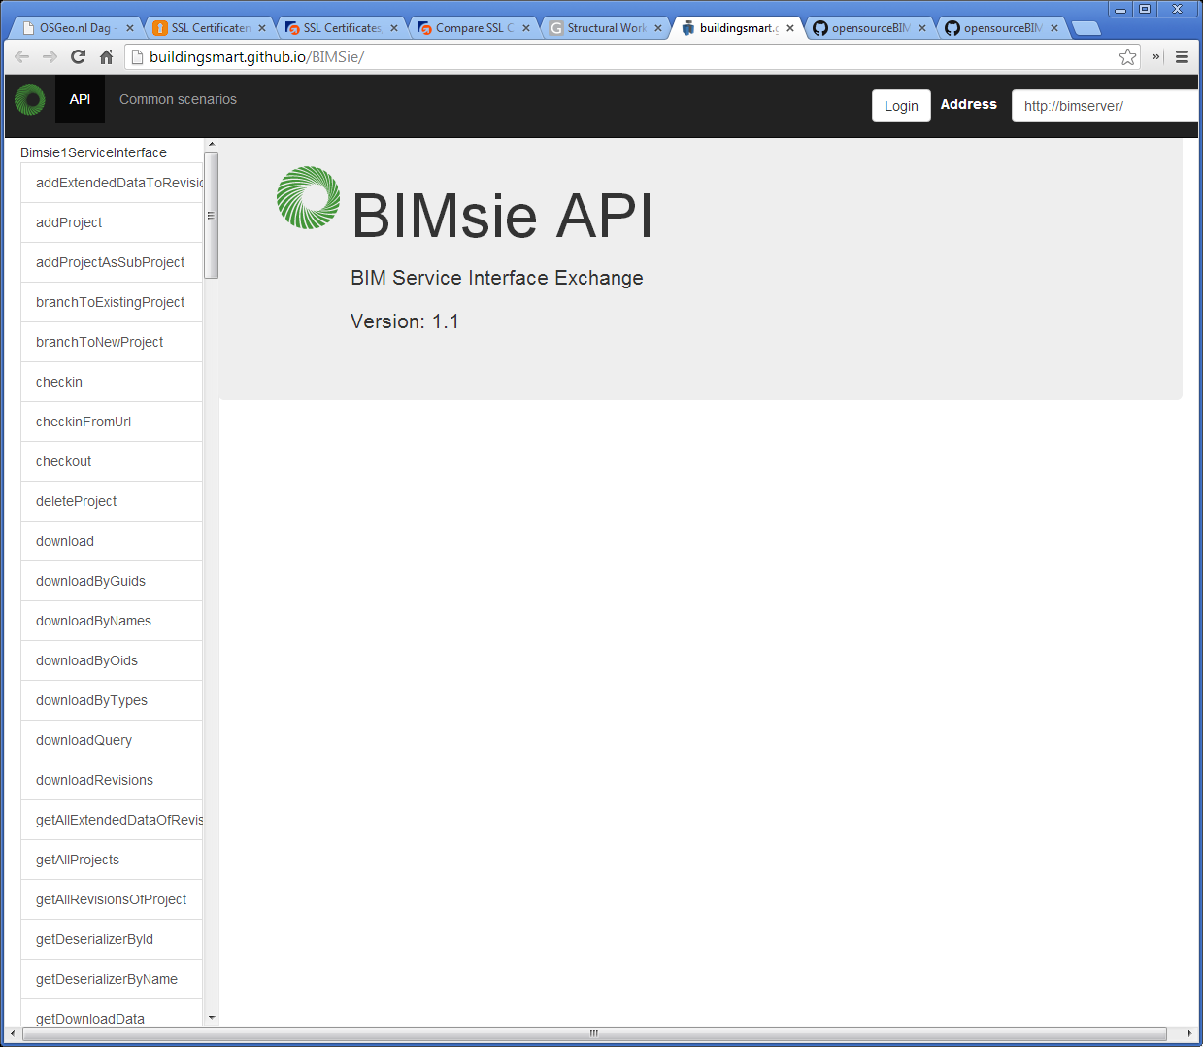
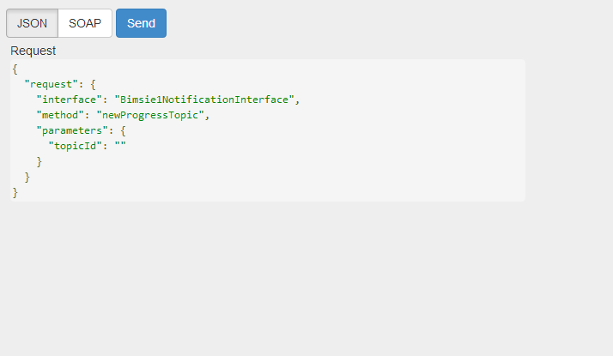

Slide 42
Questions? Leon.vanBerlo@tno.nl @berlotti skype: berlotti +31 6 423 674 65 www.bimserver.org bimsie.openbimstandards.org

